Slide 1


Fundamentals of RM
RM System and Process
Leadership in RM
Incident Investigation
RM Tools & Challenges
RM in Industry
People & Org.
Application and Perspectives
On Becoming a
Leader in Risk Management
ENGG404 - Lecture
Case 2: The Fernie Memorial Arena Loss Incident (2017) and an Examination of Risk Management System Elements

Slide 2
Learning Outcomes:
Critique the actions of on-site leadership (or lack thereof) by comparing actions with the elements of the APEGA Risk Management System in a medium-sized organization (municipal government and infrastructure management) which manages significant risks in their daily jobs across the city.
Case 2: The Fernie Memorial Arena LI and RME’s Examination
2
Notes:
2

Slide 3
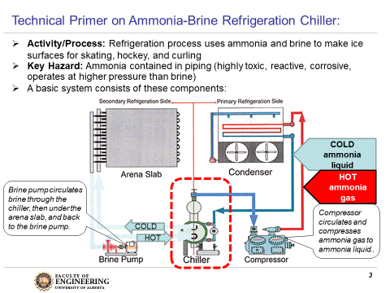
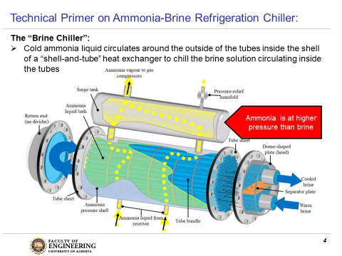
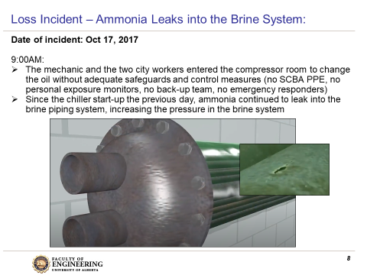
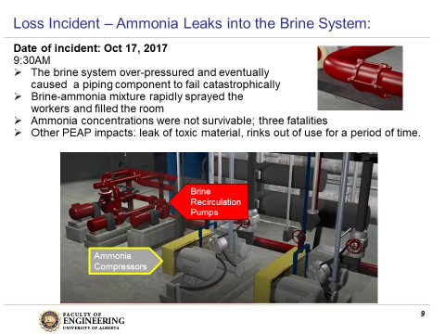
Recall from Case 2: Fernie Memorial Arena LI Background:
Case 2: The Fernie Memorial Arena LI and RME’s Examination
3
Notes:
3

Slide 4
Key Points of the Loss Incident:
The City of Fernie Municipal Government (MG) owns, operates, and maintains the Fernie Memorial Arena (city workers were dispatched to the scene).
Workers understood hazards of ammonia as evidenced by their wearing SCBA on their first entry to the mechanical room.
… but for the second entry:
Workers underestimated:
Potential quantity of the leakage from the ammonia system to the brine system
Build-up of pressure on the brine-side of the system
Pressure of the ammonia system exceeding the pressure-rating of the brine side
The potential for the over-pressure condition to rupture the brine piping system
Workers did not wear self-contained breathing apparatus (SCBA). [PPE]
Q: Would a FLRA have helped? (There is no evidence that one was used.)
Case 2: The Fernie Memorial Arena LI and RME’s Examination
4
Notes:
4

Slide 5
Key Points of the Loss Incident:
Workers disabled the ammonia alarm system and ventilation system without appropriate backup controls or management of change. [Engineering Control and Administrative Control]
Workers did not initially check nor monitor for ammonia in the mechanical room. [EC & AC]
Workers did not look for “signals” (excessive pressure in the brine side? Ammonia in the brine?) i.e. something is “not right” or disregarded any of these signals. [AC, Discovery Approach, Situational awareness]
Workers did not ask and were not prepared for:
“What is something bad that can happen?”
“How bad can it be?”
“What is the worse case scenario?”
Note: The mechanical room would not meet the definition of a confined space.
Q: Would a Permit-To-Work (PTW) have helped? (No evidence that one was used.)
Q: Would a detailed Job Safety Analysis / Safe Maintenance Procedure / Safe Operating Procedure JSA/SMP/SOP) have helped? (No evidence that these were used.)
Case 2: The Fernie Memorial Arena LI and RME’s Examination
5
Notes:
5

Slide 6
Organizational Factors:
Organizational Factors can drive decisions in unintended ways:
Recall that it was old equipment near or at end-of-life
Equipment - who is responsible for:
Assessing risks on end-of-life equipment?
Developing and implementing alternative and temporary controls to manage risks on end-of-life equipment?
Making the decision that the risk level for end-of-life equipment without alternative and temporary controls is acceptable / not acceptable?
The capital replacement budget?
City Workers and Contractors - who is responsible for:
Risk assessment training on ammonia-brine refrigeration systems and their hazards?
Risk assessment training of abnormal / upset / unusual workplace conditions?
Ensuring the use of FLRA, JSA/SOP/SMP, SQRA?
Case 2: The Fernie Memorial Arena LI and RME’s Examination
6
Notes:
6

Slide 7
A Brief Summary of Causes:
    Immediate Causes (sub-std conditions, sub-std practices):
  Pin-hole leak
  Brine system was over-pressured and ruptured
  Did not recognize nor manage / control the potential for system rupture
Basic Causes (EDF, JF, PF):
  Relating to the Release: inadequate monitoring of the pin-hole leak and system pressures; lack of over-pressure protection on the brine system
  Relating to assessment of risks: lack of using FLRA, JSA/SOP/SMP/SQRA
  Relating to Mitigation (preventing release, or reducing impact of release): inadequate emergency preparedness and response
  Relating to the Exposure: lack of personal protective equipment
    Latent Causes (Weaknesses in which RMS Elements?):
  Let’s explore this area further…
Case 2: The Fernie Memorial Arena LI and RME’s Examination
7
Notes:
7

Slide 8
ALE #1: Identify and Describe Weaknesses in the RMS
Please confer (open discussion):
Not considering any weaknesses in the first element (MLCA), select any other element of the risk management system and describe how the that element was weak i.e. the rationale behind a latent cause.
Risk Management System (APEGA Model):
Management Leadership, Commitment and Accountability (MLCA)
Risk Assessment and Management of Risks (RAMR)
Community Awareness and Emergency Preparedness (CAEP)
Management of Change (MOC)
Incident Reporting, Investigation, Analysis and Actions (IRIAA)
Program Evaluation and Continuous Improvement (PECI)
Design, Construction and Start-up (DCSU)
Operations and Maintenance (OM)
Employee Competency and Training (ECT)
Contractor Competency and Integration (CCI)
Operations and Facilities Information and Documentation (OFID)
Case 2: The Fernie Memorial Arena LI and RME’s Examination
8
Notes:
8

Slide 9
Discussion on RMS Elements #2 & #3:
#2 Risk Assessment and Management of Risks:
The hazards of a release of ammonia were understood but the potential for an ammonia-brine leak, brine system over-pressure and rupture were neither understood nor recognized.
The job to “change the oil” and the breadth of hazards associated with a system under “upset” conditions were not properly assessed.
#3 Community Awareness and Emergency Preparedness:
Fernie MG illustrated deficiencies in the procedures for handling emergencies, both by the city workers and contractor employees.
It showed the need for organizations to collaborate with the community emergency services to identify incidents that might occur and their consequences, drawing up plans to cope with them and exercising these plans – sounds like good risk management!
Case 2: The Fernie Memorial Arena LI and RME’s Examination
9
Notes:
9

Slide 10
Discussion on RMS Elements #4 & #5:
#4 Management of Change:
We often think of management of change as changes in areas such as design, operating procedures, equipment replacement, etc.
It is certainly apparent that MOC was not applied for the unusual / upset / abnormal shut-down and repair of the refrigeration system i.e. doing something different.
#5 Incident Reporting, Investigation, Analysis, & Action:
Had similar events or close calls / near-misses happened in Fernie or other municipal arenas, and had these been reported, investigated, and analysed?
The BC Provincial Government certainly did so after this loss incident.
Case 2: The Fernie Memorial Arena LI and RME’s Examination
10
Notes:
10

Slide 11
Discussion on RMS Elements #6 & #7:
#6 Program Evaluation and Continuous Improvement:
Had senior management from the Fernie MG conducted any:
On-site audits of work practices and the required administrative controls (PTW, FLRA)?
Checked training programs on FLRA? Refrigeration systems? Risk assessment tools
#7 Design, Construction, and Start-Up:
Building and maintaining the competency of employees and contractors in operating/maintaining/repairing complex unit operations with significant “process safety” hazards (compressed ammonia gas), and implementing safeguards
Similarly, were senior managers aware of the hazards of compressed ammonia gas, and do they have a “grasp” of the purpose of or the necessity of process safety systems in controlling the hazards of compressed ammonia gas?
Case 2: The Fernie Memorial Arena LI and RME’s Examination
11
Notes:
11

Slide 12
Discussion on RMS Elements #8 & #9 & #10:
#8 Operations and Maintenance:
Did the city workers and contractor refrigeration mechanic deem this as “a simple, ordinary job to change the oil”?
Were their any maintenance procedures?
If so, were these maintenance procedures deficient?
If not deficient, were these followed?
Were the maintenance procedures detailed, based on a Job Safety Analysis or Semi-Quantitative Risk Assessment?
#9 Employee Competency & Training:
Developing and sustaining the competency of employees in operating / maintaining / repairing complex unit operations with significant “process safety” hazards, and implementing safeguards.
#10 Contractor Competency & Integration:
Checking and confirming the competency of contractors in operating / maintaining / repairing complex unit operations with significant “process safety” hazards, and implementing safeguards.
Case 2: The Fernie Memorial Arena LI and RME’s Examination
12
Notes:
12

Slide 13
Summary and Key Lessons:
The Fernie LI was the result of a breakdown in many elements of a risk management system/program e.g. #2, #3, #4, #6, #7, #8, #9, & #10.
Process safety management, a specialized field of risk management, is often under-estimated in facilities operated and maintained by organizations whose core business (education, public infrastructure, retail complexes) is NOT related to process safety, and with which we, the public, have continual exposure.
Case 2: The Fernie Memorial Arena LI and RME’s Examination
13
Notes:
13

Slide 14
Update: The City of Fernie – Replaced Ammonia with Freon:
2-Oct-2019: “We have completely removed the ammonia gas refrigeration system and installed a new ice plant that uses Freon. The risks with exposure to Freon are significantly different to ammonia gas exposure, and generally, Freon exposure is only harmful at much higher concentrations as compared to ammonia. Our new plant alarm and call-out protocols have been revised based on the Freon plant and in collaboration with Technical Safety BC. In the first year of training our staff with the new plant, we had a management contract set up with a refrigeration contractor for any maintenance and any alarm call-outs. We have also made significant changes to our corporate safety management system as a whole and are hiring a full-time permanent employee to manage our safety system. In the linked Council agenda, you will find a staff report by me regarding this position and some of the changes towards our corporate approach to workplace safety:
https://fernie.civicweb.net/filepro/documents/87449?preview=99320
Zabrina Pendon, P.Eng., MBA | Director of Operational Services | City of Fernie
Case 2: The Fernie Memorial Arena LI and RME’s Examination
14
Notes:
14

Slide 15
Any questions?
Notes:
15

